Slide 1

PROJECT ON POWER BI Task-1
PRESENTED BY :
MAYURI DASHRATH KHATPE

Slide 2
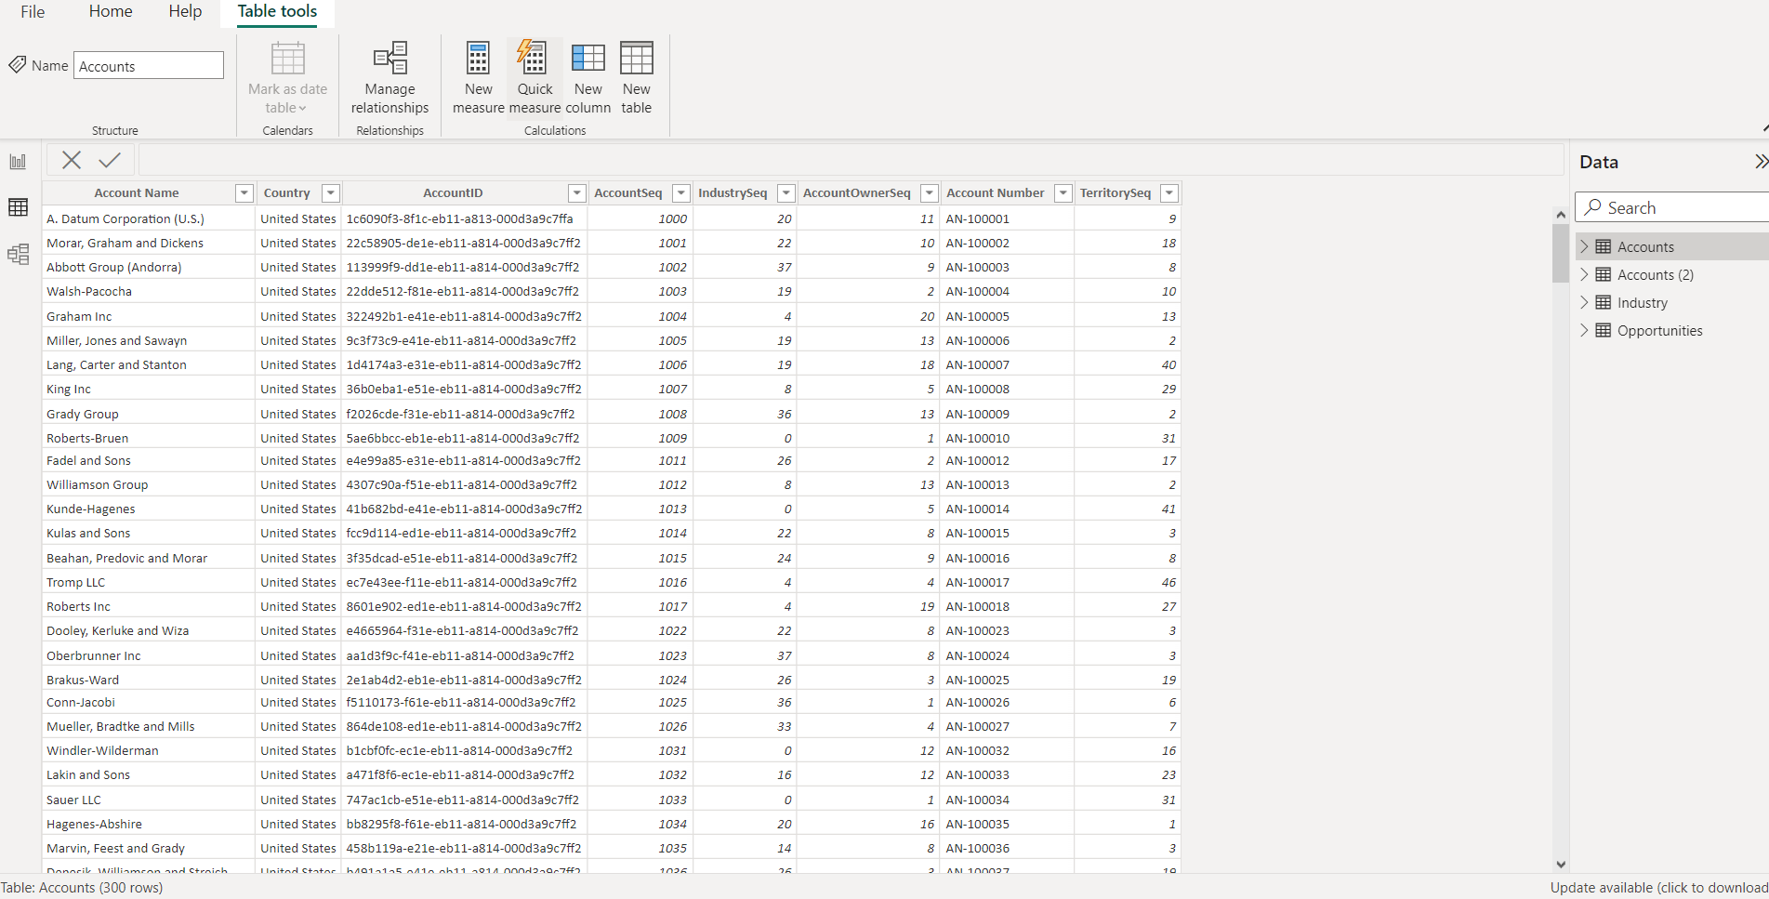
Part 1
Business(Account) Data Dashboard
Account sheet

Slide 3
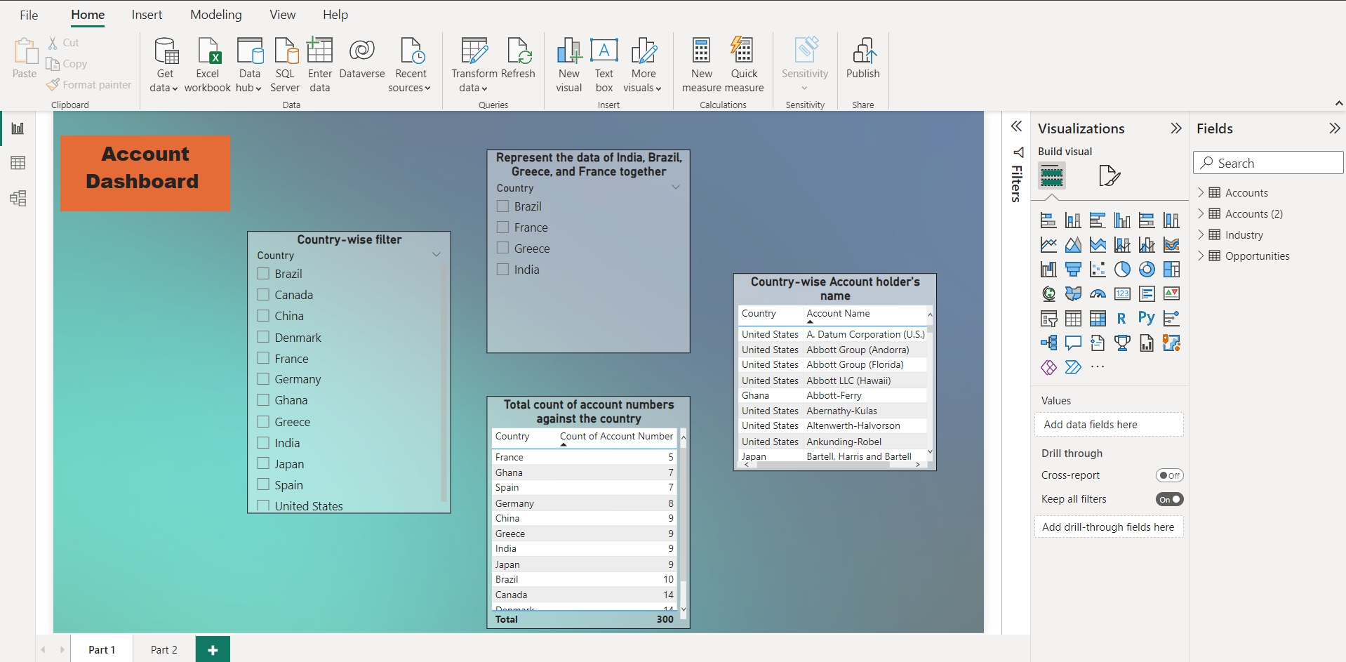
Account Dashboard

Slide 4
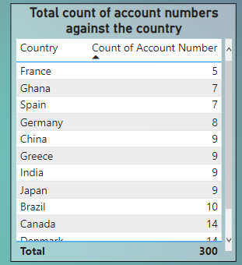
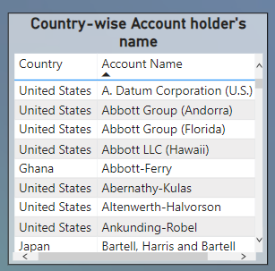
A. Represent the data, which includes the total count of account numbers against the country, in a tabular format.
B. Insert another table and represent the data on the country-wise Account holder's name.

Slide 5
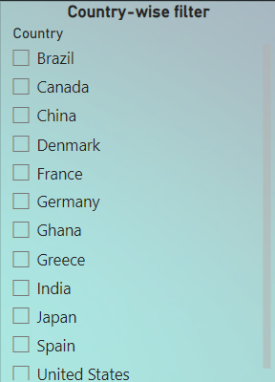
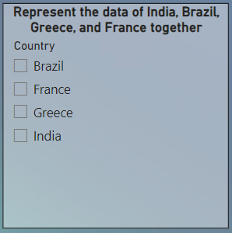
C. Insert a slicer from the visualization section and add a country-wise filter.
D. Represent the data of India, Brazil, Greece, and France together.

Slide 6
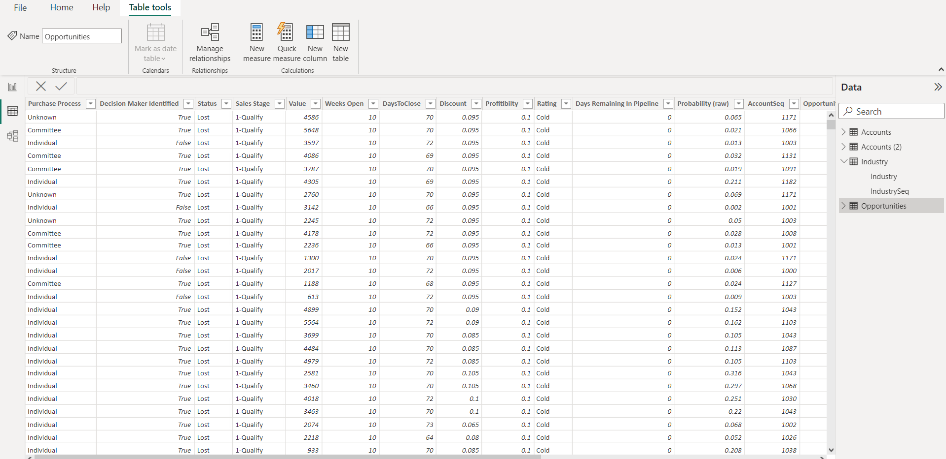
Business Data Dashboard
Part -2
Business Data

Slide 7
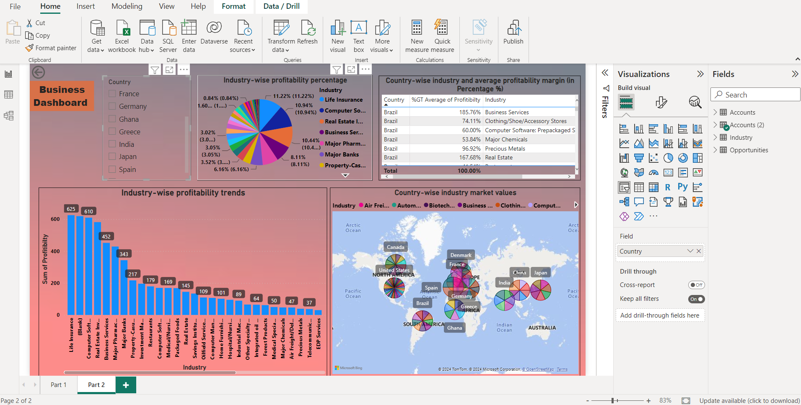
Business Dashboard

Slide 8
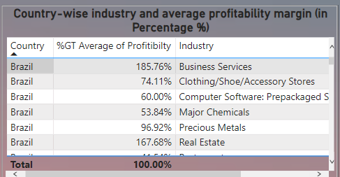
1) A. Country-wise industry and average profitability margin (in Percentage %)

Slide 9
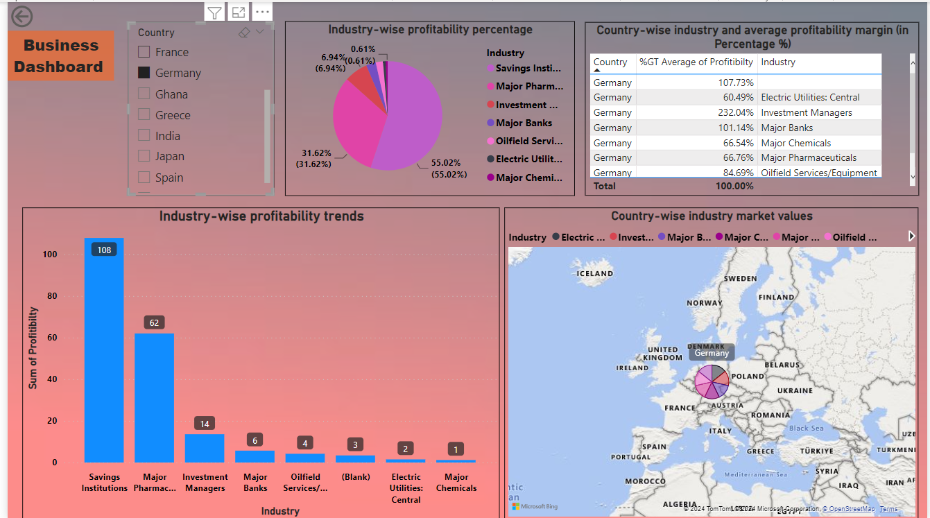
B. Add a separate filter so that country-wise industry and profitability margins can be shown based on the selective countries (There is no bar on country selection).

Slide 10
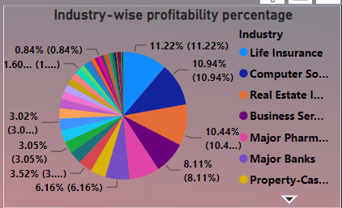
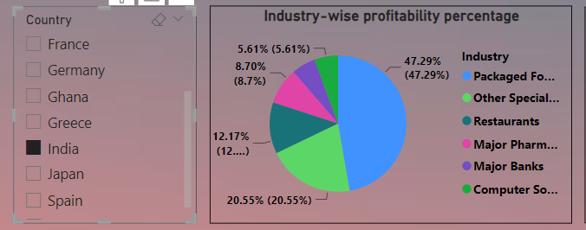
2 . Represent the following data using a pie chart:
a. Industry-wise profitability percentage
b. The data should be visualized in single or multiple country-wise

Slide 11
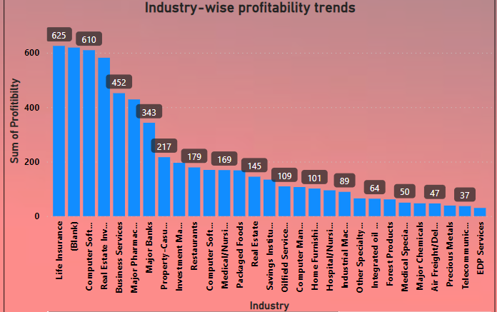
3. Present the data that shows industry-wise profitability trends by taking the Line & stacked column chart from the visualization section.

Slide 12
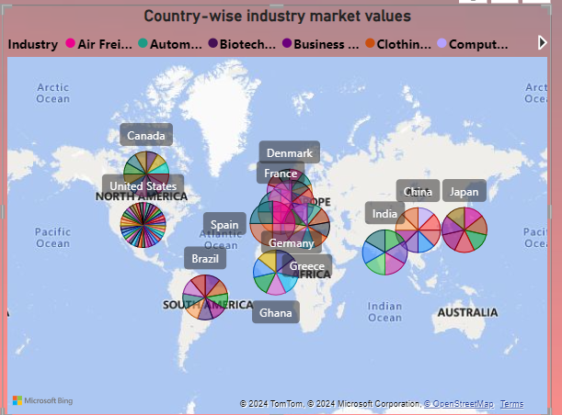
4.Present the data to show country-wise industry market values and industrywise presence by taking the map chart.

Slide 13

THANK YOU……… ………………

